Slide 1
CLADE Symposium :
STRABISMUS / ANISOMETROPIA AND REFRACTIVE SURGERY
Indications and contraindications
Lionel Kowal
Melbourne Australia

Slide 2
STRABISMUS / ANISOMETROPIA AND REFRACTIVE SURGERY
Indications and contraindications conclusion:
As part of the treatment of strabismus in 2013, Refractive Surgery is probably not used enough by many/ most Drs ….and is in danger of being used too much by some

Slide 3
Bielschowsky 1920’s
..even the most senior ophthalmologist feels uneasy about motility issues until s/he has mastered the basic physiology…
The physiology is seminal to appreciating and managing the interface between strabismus and refractive surgery

Slide 4
Evolution of Refractive Surgery / strabismus interface
1. Avoid trouble – how to pick the patients that refractive surgery might make worse, without denying patients a quality of life enhancing procedure
Nearly all myopia ± astigmatism

Slide 5
Evolution of Refractive Surgery / strabismus interface
2. Refractive surgery on patients with past or persisting strabismus
Difficult – sometimes very difficult
Nearly all myopia ± astigmatism

Slide 6
Evolution of Refractive Surgery / strabismus interface
3. Hyperopia Today > 25% of RS is for hyperopia
ASSOCIATION WITH & PREDSIPOSITION TO STRABISMUS:
If recognised before RS:
patient’s problem
Not recognised before RS:
your problem

Slide 7
Evolution of Refractive Surgery / strabismus interface
3. Hyperopia Today > 20% of Refractive Surgery is for hyperopia

Slide 8
EYE, 1997 index case

Slide 9
Refractive surgery to treat accommodative ET
16 published series to 2012
52 children 5 series ≥ 6
187 adults Σ 239 patients
7/16 series cover ~1/2 the pts : some complications
COMPLICATIONS
PRK: usually transient haze
LASIK: Loss of ≥ 1 line of BCVA in 7 series.
Other complications: corneal striae, diffuse lamellar keratitis, permanent corneal opacity, need for enhancement procedure, decentration of ablation.

Slide 10
Why consider refractive surgery when traditional treatment methods for accommodative ET are so good?
Indications 1
Hutchinson 2012
1. Informed adults & mid to late adolescent children with accommodative ET who no longer wish to wear glasses or contact lenses now have a fairly safe & fairly reliable alternative
Main issue: stability of refraction – not enough data in the strabismus population

Slide 11
Why consider refractive surgery when traditional treatment methods for accomm ET are so good?
Can now tell parent of every 3 yr old that if the + doesn’t go away with time and if glasses or CLs become unacceptable then refractive surgery age ~20 is an option
In the 16 series above, nearly all patients had acceptable alignment outcomes after undergoing refractive surgery (± strabismus surgery), even in cases where residual hyperopia was present after refractive surgery.

Slide 12
Hyperopia is not the mirror image of myopia
MYOPIA | HYPEROPIA
Reduced vision since school age Habitual prescription is worn for good vision Laser target = cyclo refraction; easily defined, easily checked | Good uncorrected vision most of their lives Habitual prescription is being worn for good vision AND for control of esodeviation Laser target depends on age, total hyperopia, manifest hyperopia, habitual glasses. Harder to define & check

Slide 13
Myopia | Hyperopia
Early clinical success / patient satisfaction correlates with accuracy of corneal reshaping Late success: little / no change. Issues: 2ary aberrations, late ectasia, presbyopia | Early success depends on: Corneal reshaping & Amount and symmetry of residual hyperopia & Residual accommodative amplitude Late success depends on 1, 2 & 3, & 4. Presence and magnitude of latent hyperopia - Expect ‘recurrence’ of hyperopia & possibly ET

Slide 14
Visual and strabismic success in hyperopia surgery #1 32 yo
Wearing +4.75, + 5 DS OU no h/o strab
Lasik → residual +2.25, +2 DS
sc 6/7.5 very happy
BUT …… develops ET!
Accommodative amplitude fine for +2 DS
BUT accommodation → accommodative convergence → ET :
patient not happy

Slide 15
Visual and strabismic success in hyperopia surgery #2 50 yo
Wearing +5 DS OU CR +7 DS OU
Uncorrected asymptomatic Hyperopia : + 2DS
Refractive lensectomy / Array → plano
UCV 6/6 OU very happy
2 DS accommodation had been used to generate accommodative convergence to control an unrecognised XT
20∆ XT : very unhappy

Slide 16
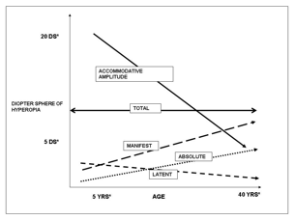
Accommodative amplitude ( AA ) is initially 25+ DS & slowly decreases with age. As AA decreases, Absolute & Manifest hyperopia slowly increase. Latent hyperopia gradually decreases and becomes Manifest
Understanding the subtypes & physiology of hyperopia
is critical to the success of refractive surgery

Slide 17
Indications 2
Hutchinson 2012
2. Children with developmental issues such as autism that preclude the use of glasses or contact lenses
Archives Ophthal, June 2009

Slide 18
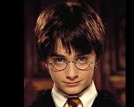
Indications 3.
Hutchinson 2012
Children/ families who refuse to wear glasses because they live in a (sub-) culture that discriminates against children with spectacles
Not new: Gobin: ‘spectacle cripple’ in 1970’s
Binocul Vis Strabismus Q. 2002;17(1):5.
Further debate regarding surgery for accommodative esotropia.Gobin MH.
Old & new options that provide a short term ‘answer’ to a long term problem:
Strabismus surgery as required for the ET, no glasses, and hope that enough motor fusion is present or develops to keep eyes straight despite uncorrected hyperopia
Refractive surgery, despite some incidence of complications and hope that the unknown natural history for this child’s refraction keeps the child spectacle free and straight
May need both

Slide 19
Evolution of Refractive Surgery / strabismus interface
4. Reducing anisometropia
Large literature on fairly successful anisometropia reduction

Slide 20
Astle 2007 results
The mean age at treatment was 8.4 y (10 mo to 16 y).
The mean preoperative anisometropia was 7DS in the entire group, 9.5 DS in the anisomyopic group, 3 DC in the anisoastigmatic group, 5.5 DS in the anisohyperopic group.
1 year after LASEK :mean anisometropic difference decreased to 1.8 D, 2.4 D, 0.7 D, and 2.3 D, respectively
54% of eyes ≤1 D of the fellow eye, 68% ≤2 D, 80% ≤3D.
Preoperative visual acuity and binocular vision could be measured in 33 children.
Postoperatively, 64% of children had improved best corrected visual acuity (BCVA), the remainder no change.
No patient had reduced BCVA or loss in fusion
Of the 33 children, 39% had stereopsis preoperatively, 88% had positive stereopsis 1 year after LASEK.

Slide 21
Astle 2007
Corneal refractive surgery sufficiently improves anisometropia to frequently reduce its effect as a barrier to effective amblyopia treatment, and should be offered to patients

Slide 22
Patient #3 JJ, 22
Surgical hyperopia treatment improves peripheral fusion
ET surgery age 12 mo
L DVD intermittent for ~10 yrs, recently worse
VA RE sc 20/20, LE +3DS 20/30
L DVD ~15Δ
CL worn: DVD rare
L LASIK for +3
L DVD gone
Similar case : DVD eye -6 DS

Slide 23
Knapp’s Law
Axial anisometropia does not cause aniseikonia [or causes less aniseikonia]
c.f.
Corneal anisometropia
EXPECT to sometimes see problems when anisometropia is surgically corrected

Slide 24
Knapp’s Law
Treating axial anisometropia by changing corneal refraction [ anisocornea] will sometimes cause clinically troublesome aniseikonia

Slide 25
Evolution of Refractive Surgery / strabismus interface
5. Introducing anisometropia - Monovision
This is the Commonest cause of binocular vision problems after refractive surgery [laser and cataract]

Slide 26
MONOVISION may cause diplopia.
1. FIXATION SWITCH DIPLOPIA
Amblyopic eye [with scotoma] becomes fixing eye in some situations.
Habitually fixing eye is now the deviating eye in those situations : no scotoma ➔ diplopia

Slide 27
MONOVISION may cause diplopia. Surgical / permanent MV
≠ intermittent / temporary MV 1
3 month MV [early PRK days] : 1/50 pts asymptomatic reduction in fusional reserve
White J.
Excimer laser photorefractive keratectomy: the effect on binocular function.
In Spiritus M ( Ed): Transactions, 24th Meeting, European Strabismological Association. Buren: Acolus Press, 1997; 252 – 56

Slide 28
Surgical / permanent MV
≠ intermittent / temporary MV 2
118 RS patients. 48 planned MV.
‘Abnormal binocular vision’ (ABV) in 11/48 (22%), ≥1 of
Intermittent / persistent diplopia
Visual confusion
‘Binocular blur requiring occlusion to focus comfortably’.
70 pts did not have MV, ABV in 2/70 (3%).
Average anisometropia in
13 pts with ABV: 1.90 DS
105 pts with normal BV: 0.50 DS (p<0.001).
Kowal L, De Faber J, Calcutt C, Fawcett S.
‘Refractive surgery and strabismus’ (Workshop in ‘Progress in Strabismology’).
In: de Faber JT, ed. Proceedings of the 9th Meeting of the International Strabismological Association, Sydney, Australia.

Slide 29
Surgical / permanent MV
≠ intermittent / temporary MV 2
3 pts with MV IOLs who developed ET with diplopia ≥2 y after IOLs
Rx: Reverse the MV
Pollard et al Am J Ophthal 2011
This paper also contained examples of CL MV causing delayed diplopia

Slide 30
Patient #4
55 yo PRE - REF SX
R -2.75/-1x85 6/9 L -2.25/-0.25x180 6/9
D: Ortho.
N : 8 Δ Esophoria. 60” stereo
POST LASIK : diplopia / visual confusion
R: P 6/6 L sc 6/15 Rx -1.75 DS
intermittent near ET 6 Δ
MV: ↓ motor fusion phoria → tropia
Glasses to correct MV: symptoms fixed

Slide 31
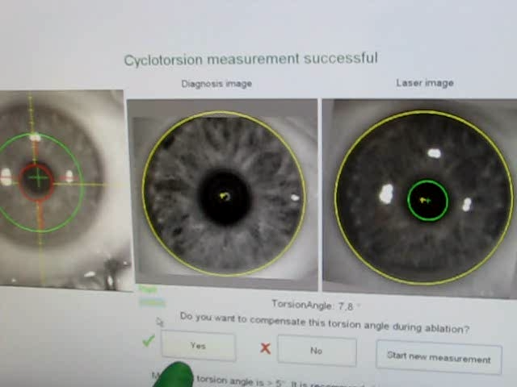
EXPLOSION in Refractive Surgery technology from
large spot PRK without even acknowledging torsion
flying spots with exquisitely accurate to 0.1° measurement & compensation for ocular torsion in order to accurately treat astigmatism
Measuring torsion in refractive surgery
This picture from Dr Ross Fitzsimmons, Sydney

Slide 32
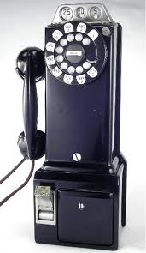
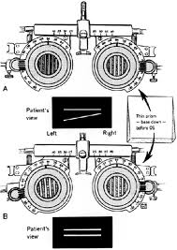
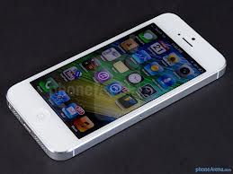
Measuring torsion in strabismus
Still in 19th century!!
Accuracy ± 2-3° at best
We have a LONG way to go………..

Slide 33
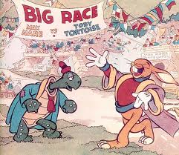
Thank you

